Slide 1
A New Year’s ReVolution
Just one letter makes a world of difference!
By Andy Acreman
Thurrock Christian Fellowship
29th December 2024

Slide 2
Resolutions or ReVolutions?
Only 36% of New Year’s resolutions survive beyond January
Only 9% manage to last the whole year
95% of resolutions are health/fitness related
1 Timothy 4:8 NIV. For physical training is of some value, but godliness has value for all things, holding promise for both the present life and the life to come.
What does godliness look like in our daily lives?
What kinds of changes could we make in 2025?

Slide 3
Divine Dissatisfaction - 1
Philippians 3:10-14 NIV. I want to know Christ – yes, to know the power of his resurrection and participation in his sufferings, becoming like him in his death, ¹¹ and so, somehow, attaining to the resurrection from the dead. ¹² Not that I have already obtained all this, or have already arrived at my goal, but I press on to take hold of that for which Christ Jesus took hold of me. ¹³ Brothers and sisters, I do not consider myself yet to have taken hold of it. But one thing I do: Forgetting what is behind and straining toward what is ahead, ¹⁴ I press on toward the goal to win the prize for which God has called me heavenward in Christ Jesus.

Slide 4
Divine Dissatisfaction - 2
Paul knew that he had not yet ‘arrived’
He was not comfortable, complacent or content with his current level of spiritual progress
Let’s examine ourselves for signs of contentment or complacency with…
  Our personal spiritual state
  TCF’s size, growth and spiritual ‘temperature’
Ask the Holy Spirit to give us dissatisfaction with the status quo and a hunger for more godliness

Slide 5
Set our Hearts & Minds on Things Above - 1
Colossians 3:1-3 NIV. Since, then, you have been raised with Christ, set your hearts on things above, where Christ is, seated at the right hand of God. ² Set your minds on things above, not on earthly things. ³ For you died, and your life is now hidden with Christ in God.
Ephesians 2:6 NIV. And God raised us up with Christ and seated us with him in the heavenly realms in Christ Jesus…
2 Corinthians 4:18 NIV. So we fix our eyes not on what is seen, but on what is unseen, since what is seen is temporary, but what is unseen is eternal.

Slide 6
Set our Hearts & Minds on Things Above - 2
It is the devil’s main objective to take our hearts and minds off heavenly things and to invite us to fix them on almost anything else! One of his best tools is this device: the so-called smart phone! Whenever we have a free space in our lives, the devil tries to feed us with what is on it – to avoid us being alone in our heads – because then we might begin to think heavenly thoughts. It’s by far the best spiritual anaesthetic around!
So let’s ask God to make us heavenly-minded and heavenly-focussed. Let’s give ourselves some head-space in 2025 to let Him speak to us!

Slide 7
Desire, Expect, Rely on the Supernatural - 1
Galatians 3:5 NIV. So again, I ask, does God give you his Spirit and work miracles among you by the works of the law, or by your believing what you heard?
Hebrews 2:3b-4 NIV. …This salvation, which was first announced by the Lord, was confirmed to us by those who heard him. ⁴ God also testified to it by signs, wonders and various miracles, and by gifts of the Holy Spirit distributed according to his will.

Slide 8
Desire, Expect, Rely on the Supernatural - 2
Demonstrations of supernatural power – signs, wonders and miracles – are an integral part of the gospel. In our spiritually-sceptical age, they are more vital than ever. Miracles did not die out during the First Century AD! And without these, we are not preaching the full gospel of Christ.
Let’s pray for a fresh Pentecost, a fresh measure of power from heaven. Let’s resolve to take risks with the Holy Spirit and give Him room to demonstrate the truth of the gospel in our land.

Slide 9
Avoid IDOLS – Ancient or Modern - 1
1 John 5:21 NIV. Dear children, keep yourselves from idols.
Matthew 10:37 NIV. Anyone who loves their father or mother more than me is not worthy of me; anyone who loves their son or daughter more than me is not worthy of me.

Slide 10
Avoid IDOLS – Ancient or Modern - 2
Anything that detracts from our allegiance to Jesus, or which seems to have a greater call on our attention or focus or priority – is actually an idol.
‘Fones’, Football, Facebook, Food, Friends & Family, Newspapers etc… (nothing wrong with these in themselves – but it’s how they are positioned relative to Jesus).
Let’s examine ourselves, asking the Holy Spirit to pinpoint any modern idolatry in us - anything holding back God’s power and our effectiveness. (Psalm 139:23-24).

Slide 11
More Spiritual Training for 2025 - 1
Prayer and Waiting on God
Development of supernatural spiritual gifts
Building a ministry to serve God's Bride
Gossiping the gospel
Becoming a worshipper
Financial Generosity
Bible reading, study and meditation…

Slide 12
More Spiritual Training for 2025 - 2
Professor John Lennox is a Northern Irish mathematician, philosopher of science, and Christian apologist who is Professor of Mathematics at the University of Oxford. He holds a PhD from Cambridge, a DSc from the University of Wales in Cardiff, and a DPhil from Oxford. John Lennox speaks English, Russian French, German, and Spanish.
He has written a number of books on the interface between science, philosophy and theology. A modern-day C.S. Lewis.
He is one of the most intelligent men on the planet and he has successfully debated the truth of Christianity with Richard Dawkins, Christopher Hitchens and other famous atheists.
He was asked what his final words of wisdom would be to the world…

Slide 13
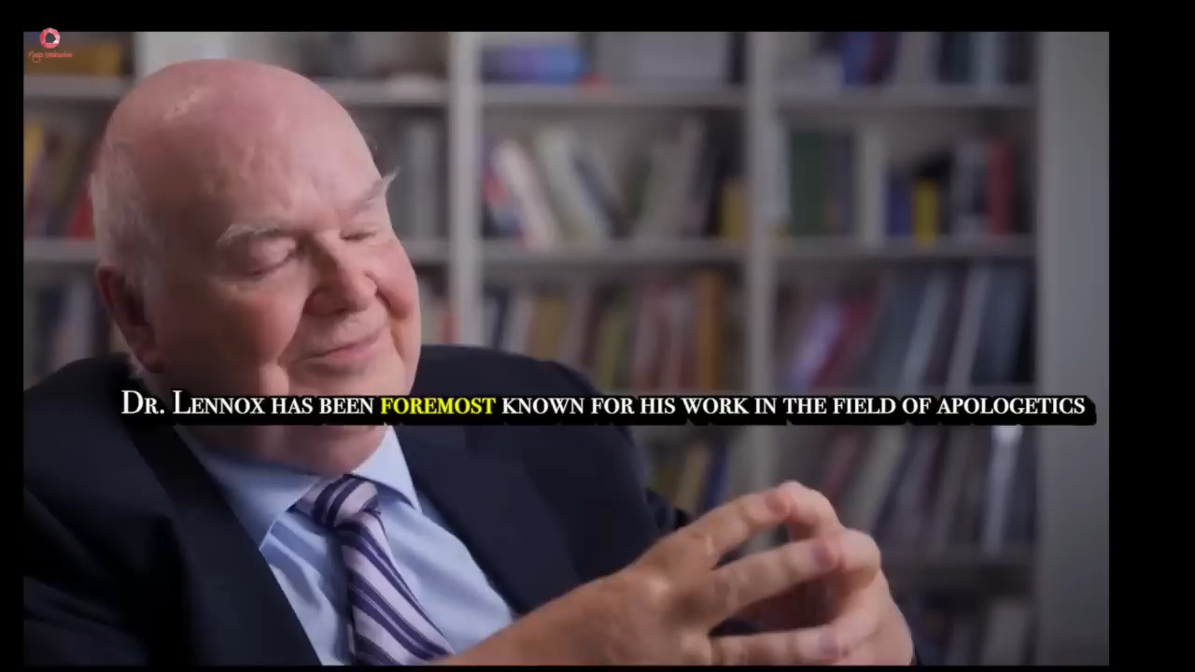
More Spiritual Training for 2025 - 3

Slide 14
More Spiritual Training for 2025 - 4
If you read the Bible and think about it, you have done Bible study; if you do this most days, you are a theologian!" We are all called to be theologians!
We need a regular bible-reading plan for daily reading (see 2 Timothy 3:16 – “All Scripture…”)
The Big Picture reading plan and notes for 2025.
https://the-big-picture.blog/about/
Free hard copy ‘Bible In One Year’…

Slide 15
RECAP
Divine Dissatisfaction
A Heavenly Focus
Reliance on the Supernatural
Avoiding Idolatry
Further Spiritual Training that we need personally, including Scripture Reading
A Revolution in our walk with God and our effectiveness for His Kingdom!
LET’s PRAY!

